Slide 1
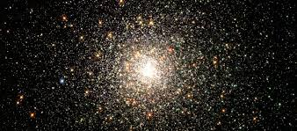

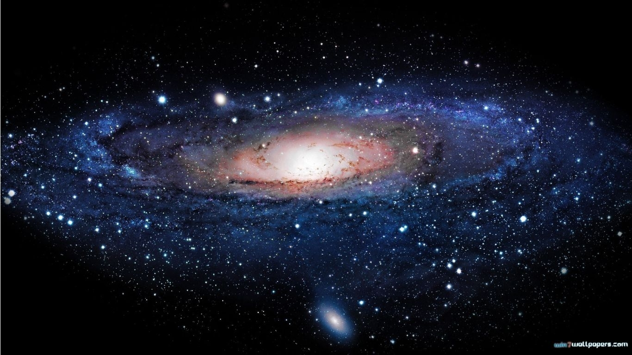
UHU Flag Option-1
(UN Flag surrounded by Andromeda and Milkyway Galaxies)

Slide 2
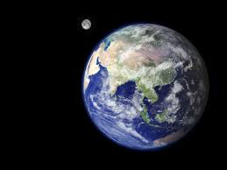
UHU Flag Option-2
(The Earth & Moon surrounded by NASA Andromeda and Milky Way Galaxies Photos)

